Slide 1
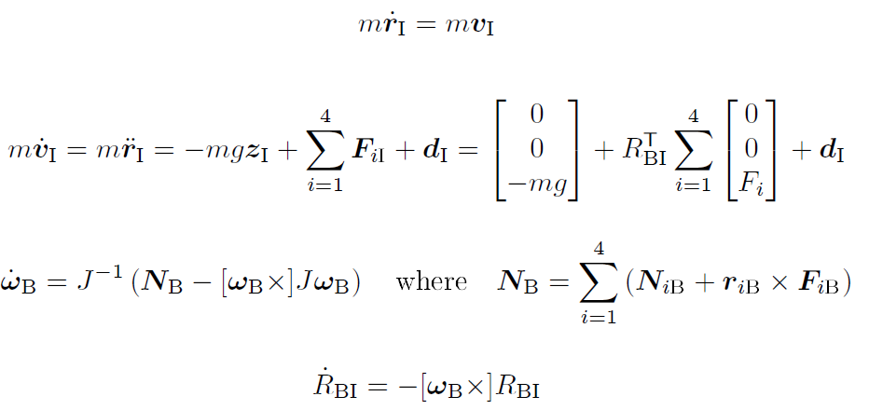

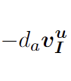
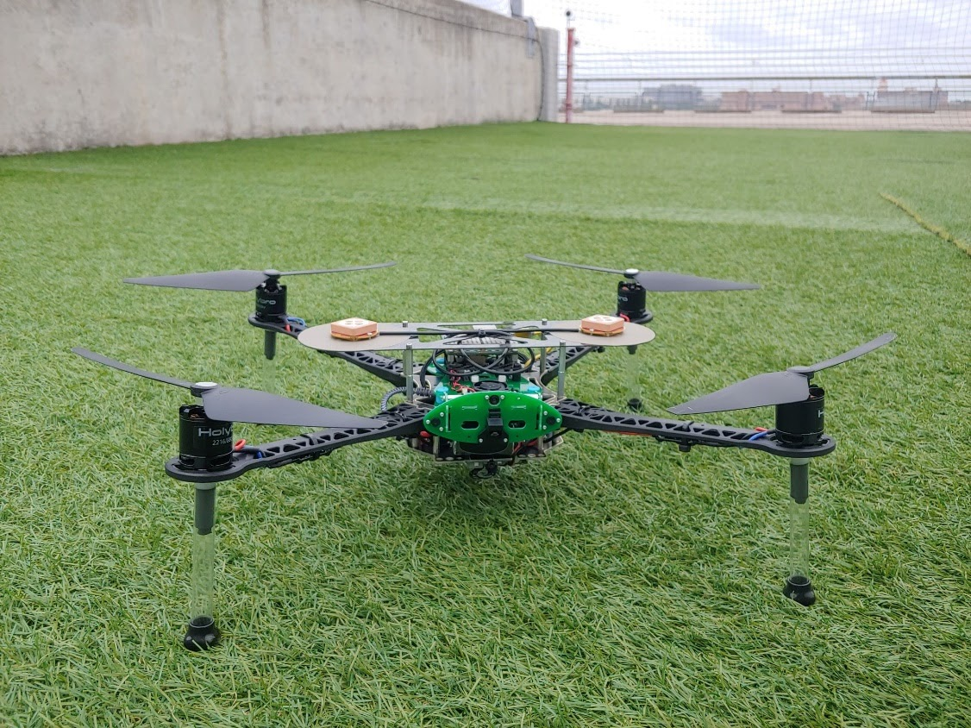
Aerial Robotics (Drone) Quadrotor Dynamics
Disturbance
Force from the Fan
Gravity
Wind Resistance
Torque from propeller acting against the air
Torque from upward thrust
Source: ASE 497W Todd E. Humphreys; University of Texas at Austin
Notes:
So, before we actually worked on the algorithm to do all that, Each of us first developed a simulation that would simulate the Drone’s flight behaviors on MATLAB.
I first modeled the drone’s dynamics with 4 ODE.
The first equation was the velocity, which is just defined here.
The dynamic equation for the acceleration was determined by the forces acting on the drone. Here is the gravity acting on the drone. The second term is the upward force exerted by the fan onto the quad which keeps the drone up in the air, and we have four of those. We have the drag force acting against the motion of the quad at the end. Lastly, any disturbance force was modeled as a noise.
The third equation is for the angular acceleration. This is what you get if you take the derivative of angular velocity. Nb term is the torque combination caused by the propellers. Specifically, NB_i is the torque caused by the propeller acting against the air, so it makes the drone spin on its own axis, like this. The R cross F term is the torque caused by the thrust force that keeps the drone in air, which could make the quad flip over.
Lastly, I have the equation for the change in the attitude matrix. Notice I used the full rotation matrix to avoid singularities or gimbal lock, instead of Euler angles.

Slide 2
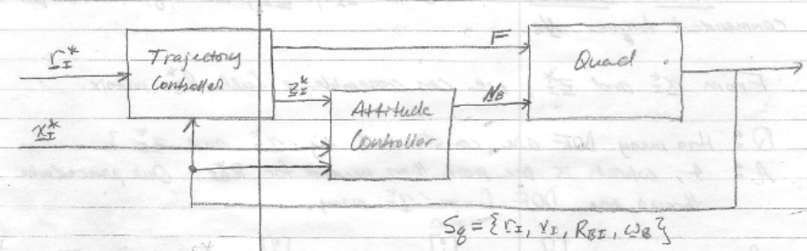
Aerial Robotics (Drone) PD controller
PD Controller
Plant
Reference or desired states are denoted with a star
Source: ASE 497W Todd E. Humphreys; University of Texas at Austin
Notes:
Here is the schematic of the control system I was simulating for. I used two controllers, one for trajectory control and another for an attitude control. PD controllers were implemented for both.
R star is the position of the drone, x star is the position of the x-axis of the drone’s body frame.

Slide 3
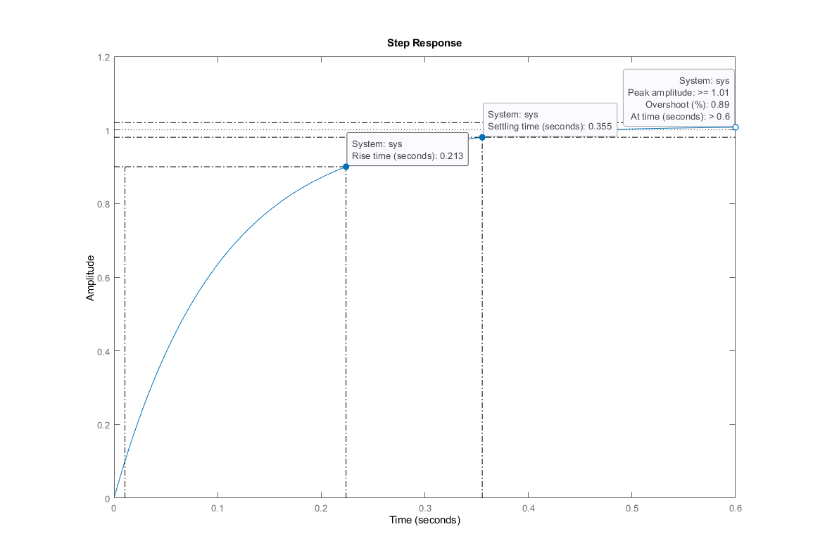
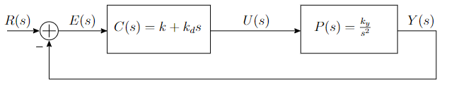
Aerial Robotics (Drone) PD controller
Notes:
But Before actually implementing PD controllers, a basic PD controller in this figure for this systmem was tuned to see how P and D gains affect the system behavior.
The goal of this exercise was to make the closed loop system’s unit step response to have less than 0.25 seconds
of rise time (Tr), less than 30 % of over shoot (Po), and less than 2 seconds of settling time (Ts) to within 2 % of reference value. .This figure shows the step response of the closed loop system with the a specific gains I chose.
Talk about how does PD affects the behavior*******************
Increasing P gain generally increases the speed of response say the reduce rise time and also reduces the setlting time.
The D gain generally decreases overshoot, but also makes it more sensitive to noise and errors.

Slide 4
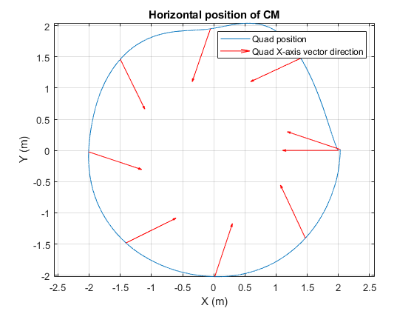
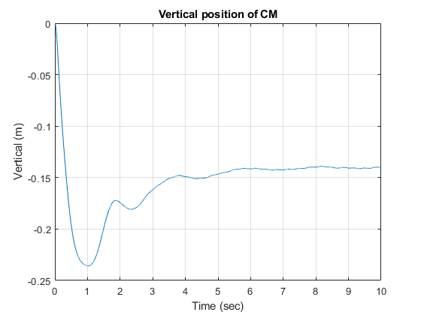
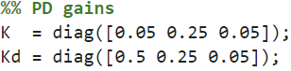
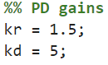
Aerial Robotics (Drone) PD controller
Attitude Controller PD Gains
Trajectory Controller PD Gains
Notes:
For The actual tuning of attitude controller was really hard, because P and D gains were in matrix form for the attiude. I tuned it until the drone followed a desired circular and a designated height as closely as possible in a MATLAB simulation. Also I wanted the quad’s front to face the center of the circle throughout the flight.
In the left figure, you see the trajectory of the drone in the simulation as a blue line. It isn’t a perfect circle, but it kind of looks like a circle. The red arrows show you the direction of the quad’s “x-axis” or I can say the front of the quad. We see that mostly, it is facing towards the center of the circle. In the right figure, the goal was to get the drone to fly at 0 m, but I got as close as 0.15 m.

Slide 5
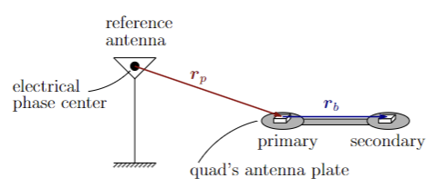
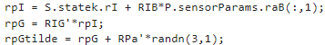
Aerial Robotics (Drone) Sensor Modeling
GNSS Measurements
Source: ASE 497W Todd E. Humphreys; University of Texas at Austin
Source: ASE 497W Todd E. Humphreys; University of Texas at Austin
Notes:
We also modeled Measurements from the GNSS antennas to find the position of the quad.
Here is the schematic of the GNSS antennas. There is one big reference antenna in the field, acting as an inertial reference frame. Although it actually is not inertial, since it is rotating with the Earth, but the inertial sensor isn’t sophisiticated enough to know that, so I was able to assume that it is inertial.
And two additional antennas are attached to the drone at its center.
So in reality and if the drone was flying and receiving GNSS measurements, the actual drone would receive according to this diagram. The position of the primary antenna in reference to the fixed antenna, rp, and also the position of the secondary antenna in reference to the primary antenna, rb
This measurement was emulated in the MATLAB simulation by taking the current actual position of the drone, adding antenna locations on the drone, and adding some noise.

Slide 6
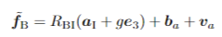

Aerial Robotics (Drone) Sensor Modeling
IMU
Accelerometer Measurement Model
Rate Gyro Measurement Model
Accelerometer
Bias
Acceleration
Gravity
Accelerometer Noise
Gyro Bias
Gyro Noise
Angular Velocity
Notes:
Here is the eqeuation of model for IMU measurments. The accelerometer measurement accounts for the accleartion of itself, gravity and the bias noted as ba and noise Va.
The accleartion term is defined in the equation below, the regular asccleartion equation lot of you know, but for this, I assumed the origin of the acclearomter was fixed to the origin of the Body, which cancles out these terms.
So essentially this FB bar omega b bar equation is what defined the IMU model.

Slide 7
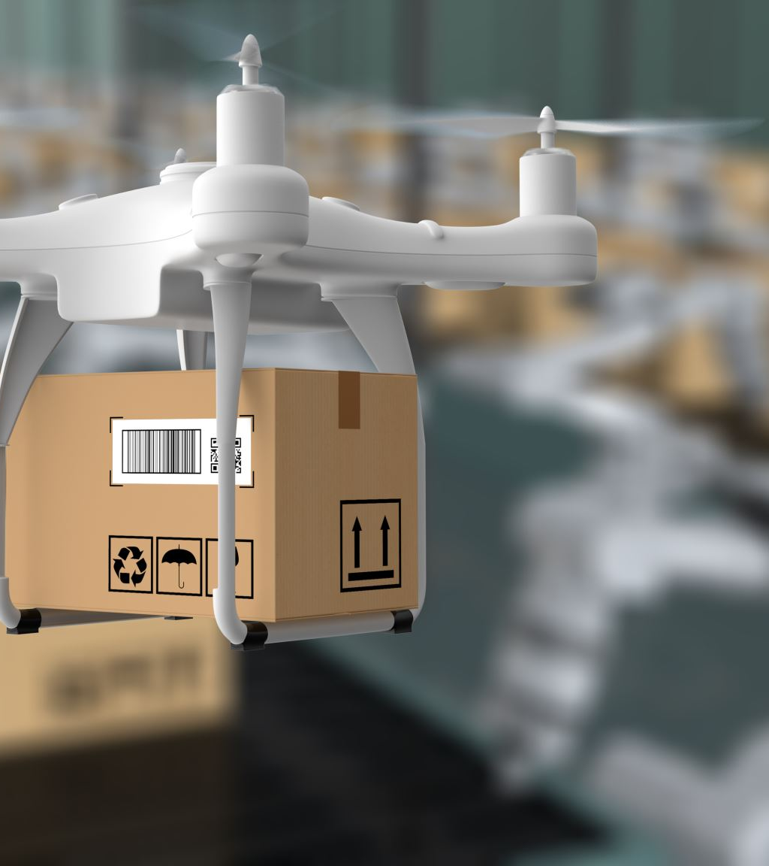
Aerial Robotics (Drone)
Additional Modeling
Camera
Unscented Kalman Filter
Full MATLAB simulation
Goal:
Follow reference trajectory
Determined by A* algorithm in C++
Maintain 0 m altitude
Notes:
Lastly, additional modleing and tool I used to complete the simulation were the camera model to detect the ballons, and the unscented Kalment filter on MATLAB that my professor provided for us for better state estimates.
With all of these models, I simulated how well the drone achieves the goal in the simulation environment, which is to follow the reference trajectory and maintain 0m altitude. In the next slide you will see the result of the MATLAB simulation I ran, and the reference trajectory I fed into it was a path determined by an algorithm that uses A* method I developed in C++, which I will explain more later.

Slide 8
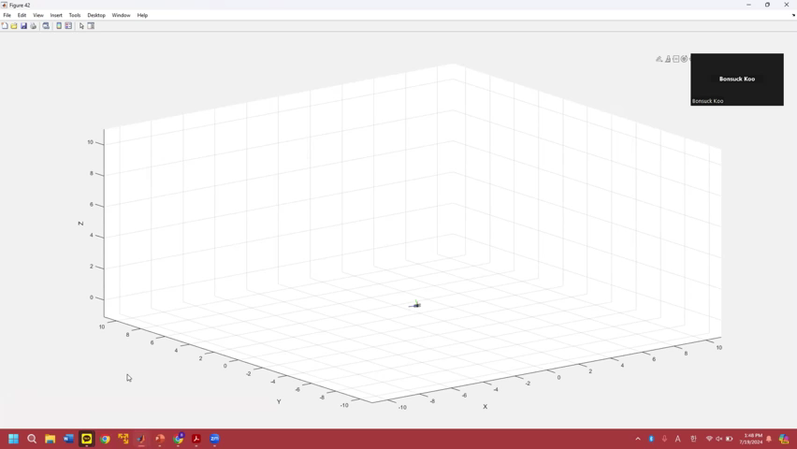
Aerial Robotics (Drone) Completed MATLAB Simulation
Notes:
You see here that the drone fooloows a certain trajectory and the x-axis or the red line always points towards the direction of travel of the drone.
After seeing the controllers working well in the simulation, I now moved on to implementing a path finding algorithm on C++

Slide 9
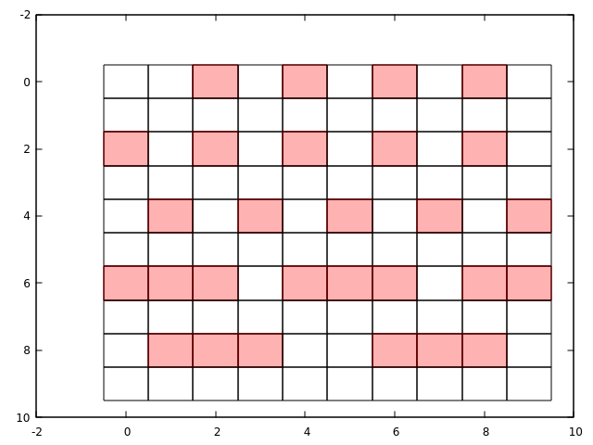
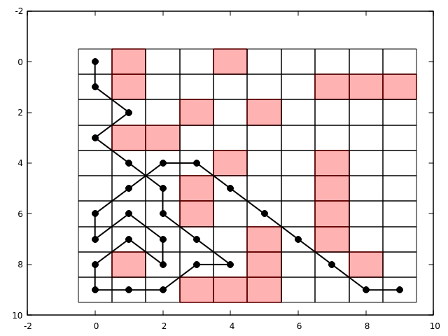
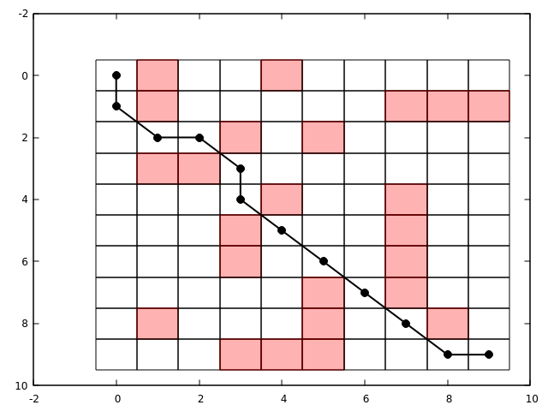

Aerial Robotics (Drone) C++: Path Finding Algorithm
Comparison of three different path finding algorithms in C++
Selection Criteria:
Number of Nodes Explored
Number of Nodes in path
A field gridded into cells and mapped into nodes. Nodes are at the center of each cell. Red cells represent obstacles.
START
END
Depth First Search (DFS)
Dijkstra’s
A*
Notes:
There were three options I considered. Depth First Serach DFS, Dijkstra’s algorithm and A* method.
How I chose one algorithm to implement was based the two criterias.
The number of nodes explored, number of nodes in path. If I explain what the picture on all the way to the right is, I think it will help understand the first criteria.
Say a field can be gridded into cells and mapped into nodes. Like the picture you see all the way to the right. The nodes exists at the vcenter of each rectangular cells. The red cells represent obstacles that the drone cannot go to.
This sort of mapping of a field is what was provided for the actual competition. The professor gave us the 3D occupancy grid that represented the actual field that the drone flew on.
So for selecting an algorithm, I used a much smaller scale and simpler 2D occupancy grid that you are seeing right here on the top right.
So back to talking about the criteria. Starting with the first criteria, So the three algorithsm have different ways of selecting which cells or nodes should be explored or not. And sometimes that algorithm could explore multiple “incorrect path” before it finds the “correct path” or other times the algorithm is smart enough to weed out certain cells right away to find the “CORRECT” path instantly without exploring other “incorrect paths”. Definitely I should prefer the latter situation, so that’s what the first criteria measures.
For the second one, it’s a much simpler criteria, that is the determined path has to be the shortest possible way, since this competition is time sensitive. For example, say if both the DFS algorithm and A* algorithm explored the same number of nodes to find its path, but obviously I would choose A* because the path it found is much shorter than the one found by DFS.
So with those criteria and also clearly seen from these pictures,
I coded all of them in C++ and tested them in the 2D test occupancy grid
The A* method was the most efficient path finding algorithm that explores the lest number of nodes and had least number of nodes in path.
Now you will see how the C++ A* algorithm I worked on looks like in the game engine simulation I was provided to work with.

Slide 10
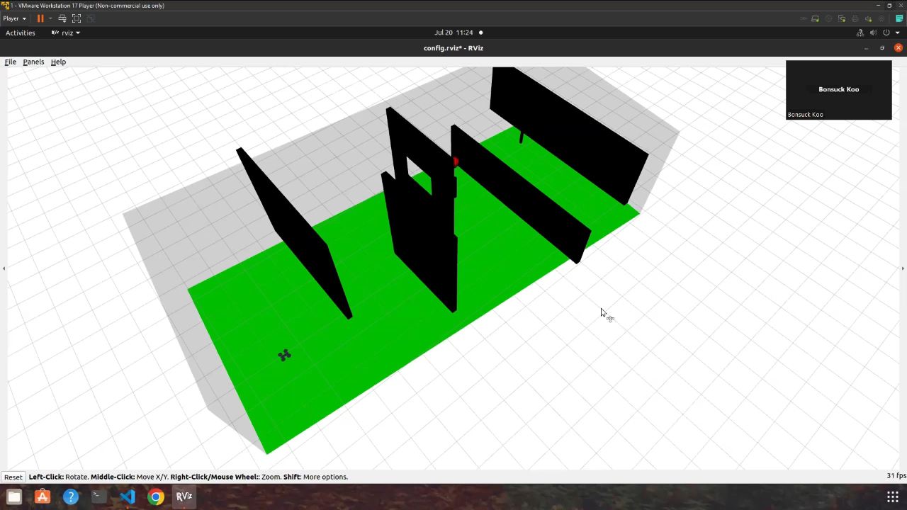
Aerial Robotics (Drone) C++: Path Finding Algorithm

Slide 11
Aerial Robotics (Drone) Team Collaboration
Communication and Feedback
GIT
Experience at Blue helped me lead the Team to utilize GitLab
Notes:
At the end, of course this competition was a team effort, and I could not have completed this project without my teammates.
The best part about having teammates is getting help from each other. When I was struggling with my part of work, my teammates had conversations with me about the relevant topics or concepts that my code pertained too. And while talking to them I would notice errors to my code. Or sometimes they would simply look at it and notice small bugs as a third person, which I didn’t notice at all by myself. We would also talk to each other give feedback to how certain codes can be better implemented, each of us would incorporate that.
I really like that and I knew the feedback would help the team, so at the beginning of this team project, I told my teammates that our team should try to communicate with each other as often as possible whether that’s text, zoom meetings or in-person meetings, so that we all will be comfortable with each other and exchange feedback and not be afraid to get or give help to each other. Our response to that was having a in-person meeting at least twice a week, we would also talk after lectures, and I really like the meetings because since we are all in the same space giving feedback was much easier than sending a text or email. And also spending time together in person also pulled the team together to work with each other even more closely.
I think it worked really well and we got a good result because of it.
I also notice the idea of active communication and feedback is one of the Blue’s leadesrship principle, “Embrace Team Blue” so I wanted to point this out.
And a short side note, I contributed to the team with my experience in GIT. I am very thankful that I struggled with GIT at Blue for a few month while I was there. None of my teammates knew how to use Git at first, so I was able to help the team set up Git repository, help if any members had issues with Git. I was glad I could do that for the team.

Slide 12
Summary of Drone Project
Situation
A competition to pop the balloons with a drone in the least amount of time
Task
Develop MATLAB simulation
Develop path finding software for the drone
Action
Apply knowledge in dynamics, classical control theory, navigation sensors ( accelerometer, gyroscopes, GNSS receiver) for MATLAB simulation
Implemented A* method in C++ for path finding algorithm
Feedback through active Communication
Git to collaborate
Result
2nd place!
Notes:
I really wanted to point this project out, because this course really felt like the software development process through SIL at Blue. Though this one is much smaller scale but it was more hands on for me since I got to develop most of the simulation and implement C++ code myself. I think these skills are super for this GNC engineering Early Career position that requires knowledge in Dyanmics, classical control theory, MATLAB, C+++ , communicatation skills, etc.
I hope this explained why this experience helps me prove I will be a good for this position.

Slide 13
Projects
Senior Design Project

Slide 14

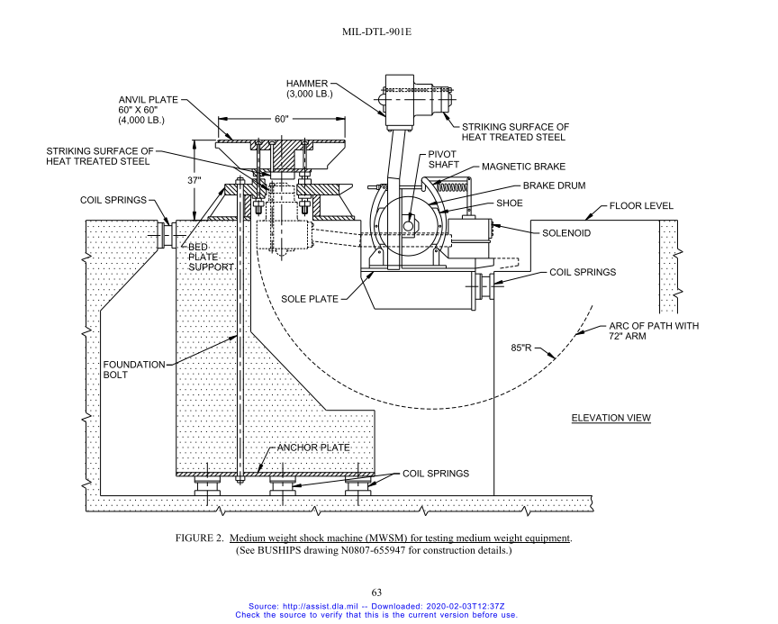
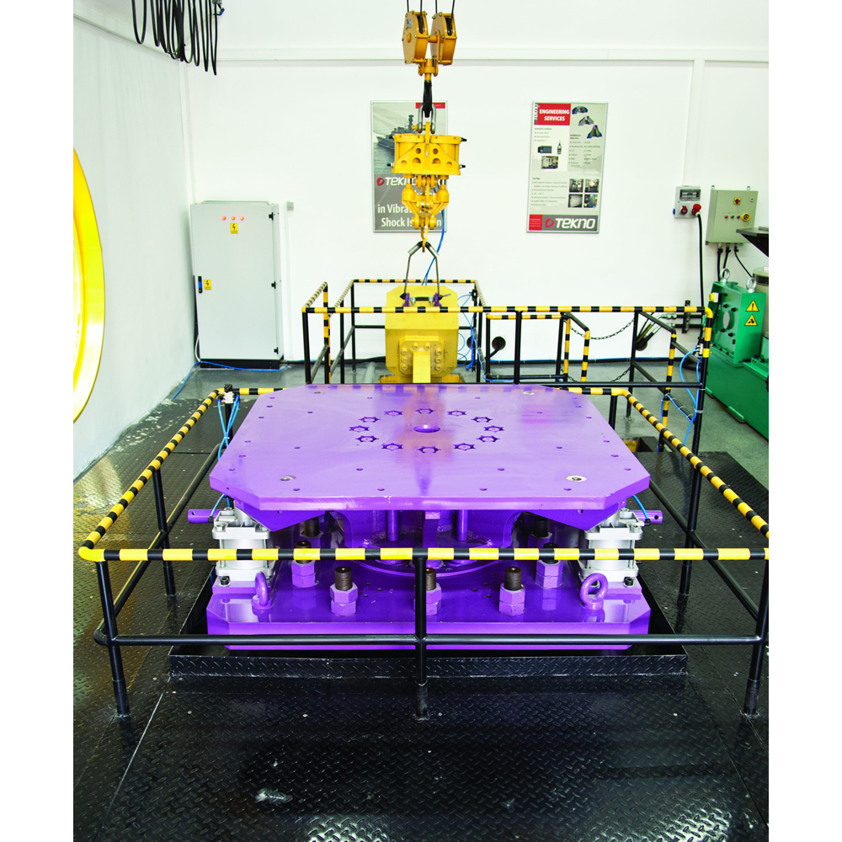
Senior Design Project Background
Team Lead
Sponsor: Southwest Research Institute (SwRI)
Design a high-impact test machine for equipment on naval ships
Comply with MIL-DTL-901E standard
Source: www.tekno-eta.com
Notes:
In the fall 2022, I was the team leader for my senior design project. Our sponsor Southwest Research Institute requested our team to design a high-impact shock test machine, and this machine is suppose to test whether naval ship equipments could withstand certain impacts according to MIL-DTL-901E standard. Here is the cover of the specification standard I had to read and a diagram that roughly delineates what a impact machine should look like. Basically an equipment sits on top of this anvil plate, and you see a hammer here and it swings around to hit the bottom of this anvil plate. That’s the test. Here is the actual picture of it in another company.
And this machine is suppose to be really big. Just the hammer should weigh 3000 lbs, it’s also taller than me which is about 6 ft, and this plate is 60 inches x 60 inches big.
SWRI wanted to build and have its own shock test machine.

Slide 15

Senior Design Project Defining the Problem
Hammer
Deliverable
CAD Model
Static Finite Element Analysis (FEA)
Confined project scope to 4 subsystems:
Brake
Hammer Lift
Mount
Notes:
In less than three months’ time, my team had to deliver a preliminary CAD design of the machine and a Static Finite Element Analysis (FEA) result. It was daunting at first to build such a big system in a relatively short amount of time. But I took the lead to plan our project together.
First, I wanted to define the scope of the project to a reasonable scale. The machine has multiple systems and components, and it was not plausible for four of us to design all the systems. During my team meeting, I brought up my concern, and my team and I came up with a proposal to design only of the four main critical systems on the machine: a Mounting System that fixes and holds the machine onto the floor, Braking System to stop the hammer after the impact, lifting system to lift the hammer, and impact system, or the hammer. We conveyed our opinion about the scope to our customer or the sponsoring engineers and were able to persuade them by explaining that given the time and the resources we have, it is best to focus on those four mechanical systems. It was critical that we did that because Not only did we have less than three months, each of us were taking other Mechanical Engineering courses, doing researches in their labs, and looking for a job while this project was going on. Our team agreed that the best way to be resourceful of our time and ability is to focus on specific systems, so we can deliver a quality result to our customer.
Having this discussion and coming up with a proposal with my teammates helped each of us feel the ownership for the project. During the discussion, it was each one of us who said that it is plausible for us to design the four systems given this time, it was us who agreed that we can deliver the results to our customers given these resources. Because we proposed to do them, I believe everyone in the team felt responsible and ownership of the tasks ahead of us.
So if I am in any other team projects, whether I am the lead or just a member, I like to clearly discuss the scope of the project and plan the project together to provide ownership of the project for everyone.

Slide 16
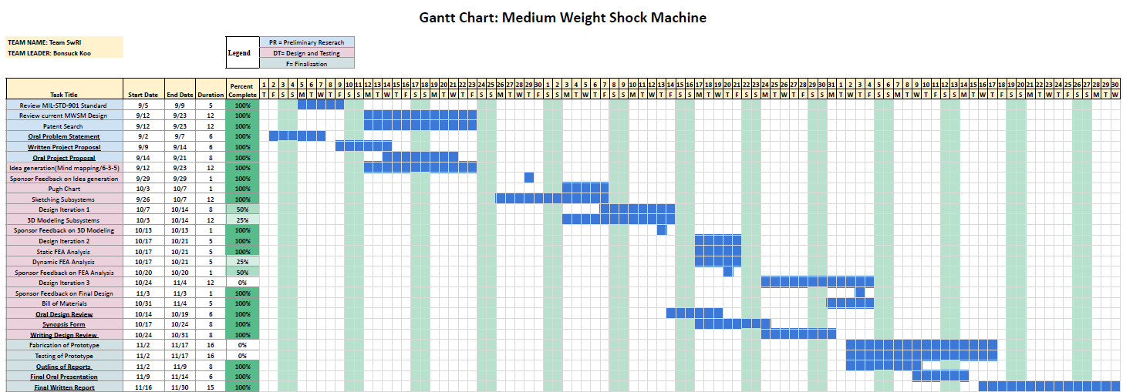
Senior Design Project Communication
Notes:
So far, I might have been giving the impression that we were too busy to do this project, but we were not. We instilled trust into the minds of our sponsor through planning and active communication.
Here is the project Gantt chart. It outlines the entire tasks and dates of when we are going to work on them.

Slide 17
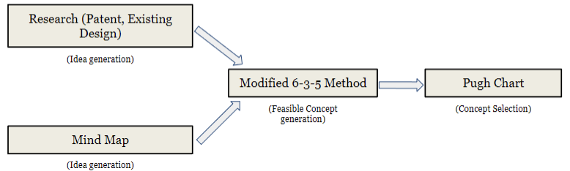
Senior Design Project Communication
Notes:
Here is a diagram explaining how we are going to brainstorm ideas, and select one idea to produce a CAD model for.

Slide 18
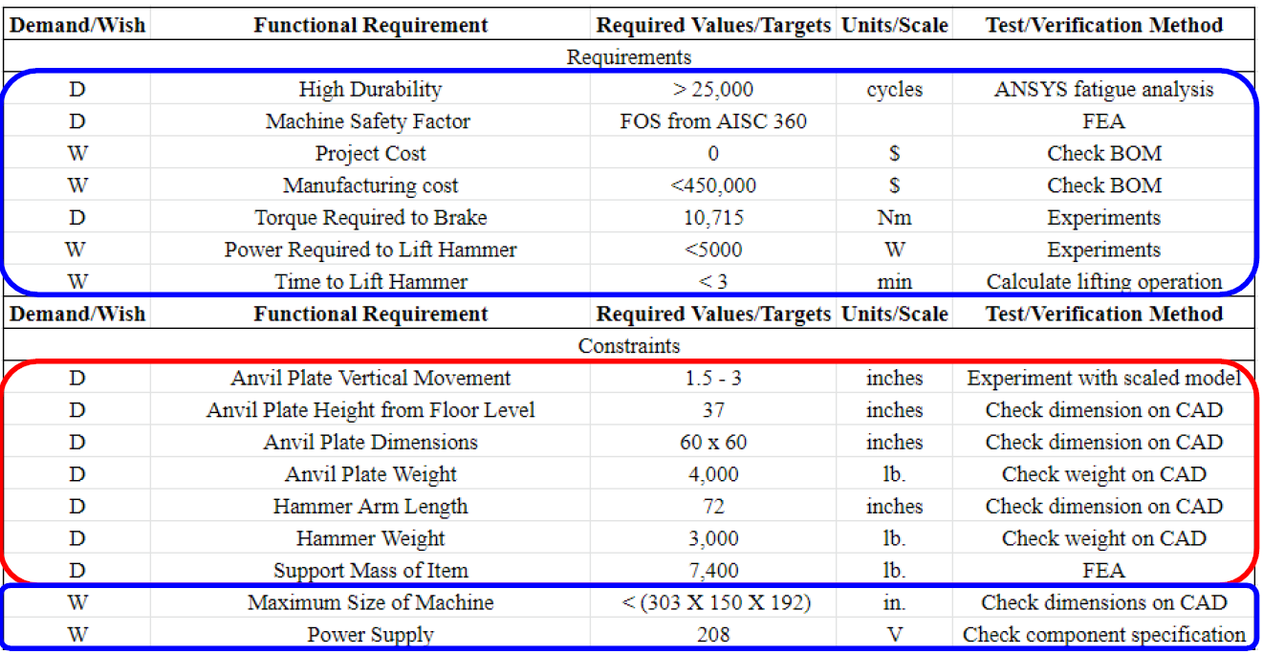
Senior Design Project Communication
Notes:
Here is the specification sheet of the machine that we created based on the requirements from the military standard and our sponsor’s demand.

Slide 19
Senior Design Project Communication
Communication with Sponsor
Trust
Show the team’s plan
Show our understanding of the project
Communication within the team
Action Items every meeting
Notes:
We showed those charts for our sponsors to have certain expectations at different times and to know what we are working on at different points throughout the semester.
And every week when we meet, we told them our progress, what worked and what didn’t work. Or sometimes, I would brief them about the summary of the military standard I read, and I would confirm my understanding with theirs.
So, It was important to show our understanding of the project as often as possible, so that the sponsor understands that we are going in the direction, and we are sure of what we are doing. One time, we were not sure how much force we should assume that the hammer and the anvil plate will experience. Our sponsoring engineer advised us to multiply the static force we caclualted by rthree for the analysis, since the three signam is the industry standard.
This kind of active communication, I believe allowed our sponsor to feel comfortable working with us and entrusted us to finish the project.

Slide 20
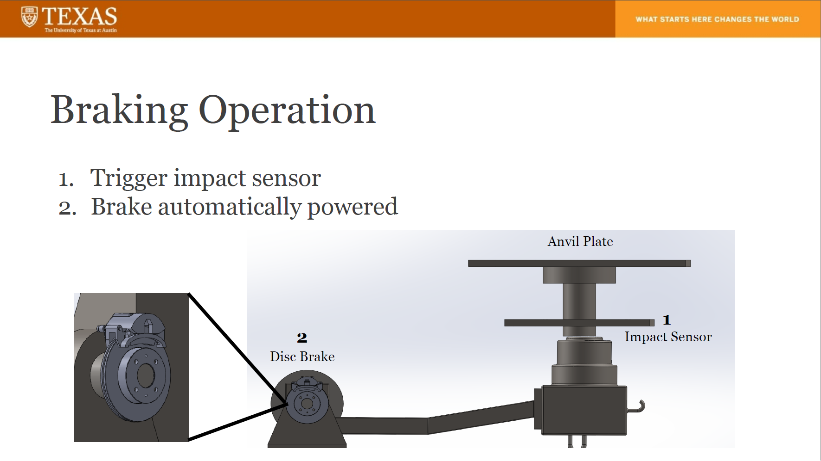
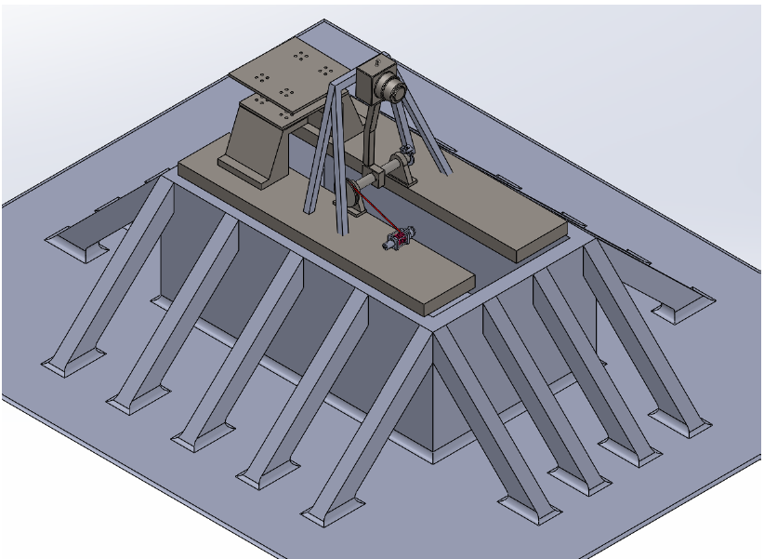
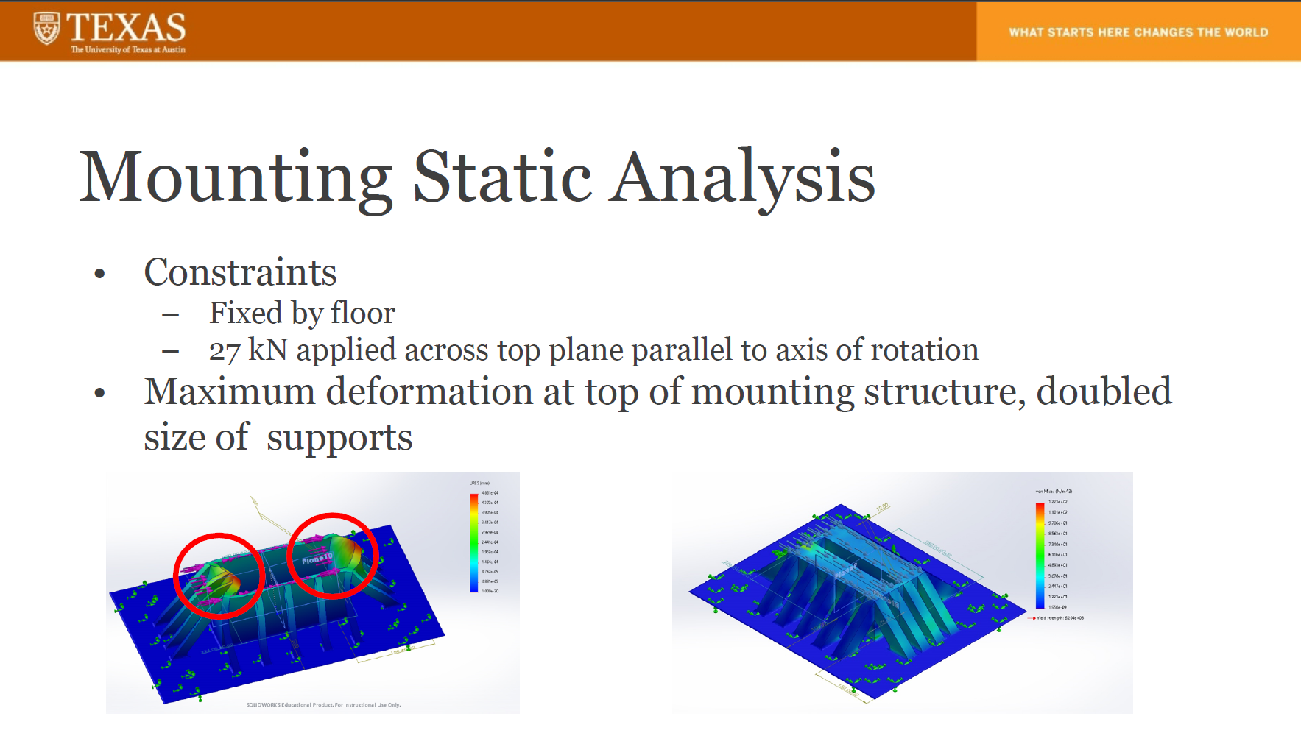
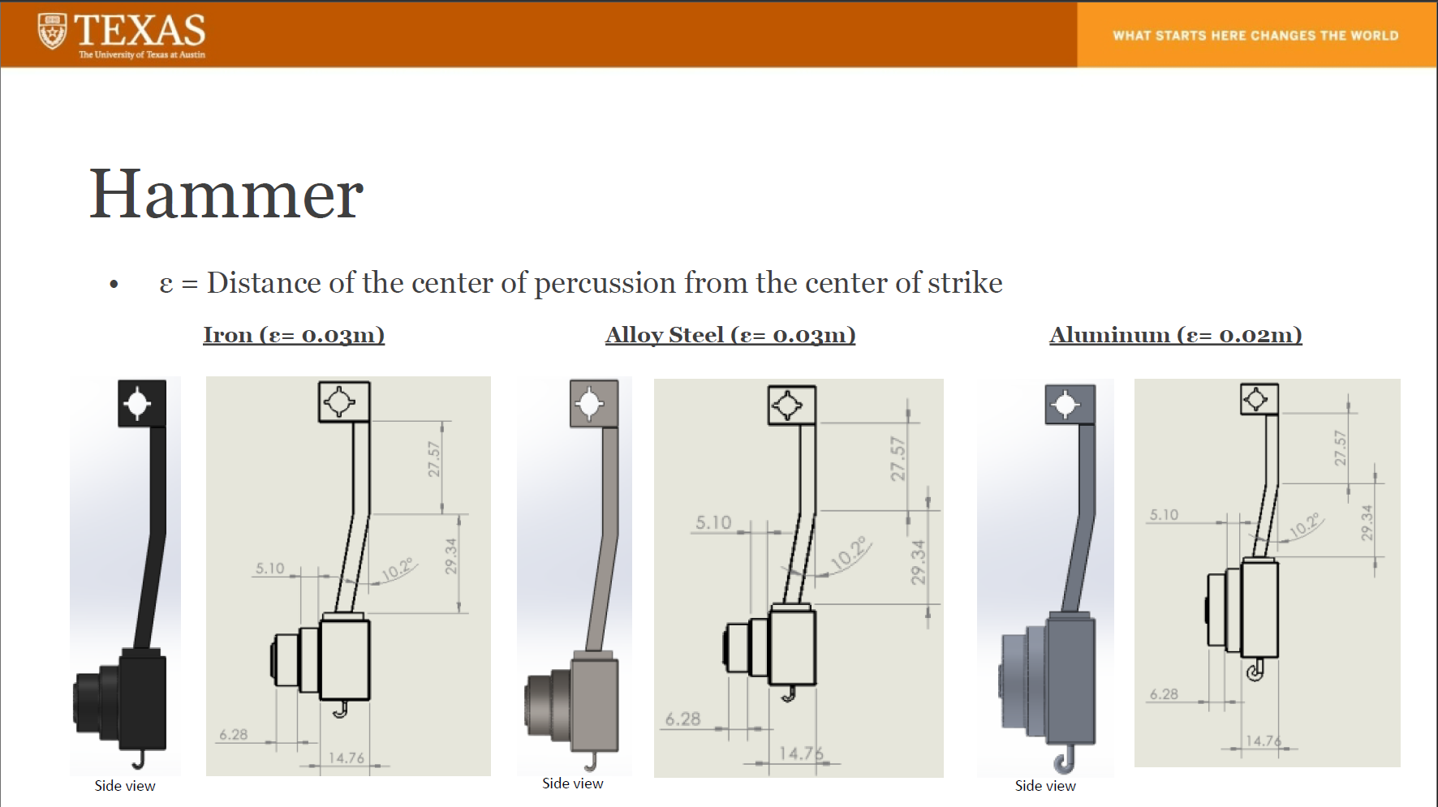
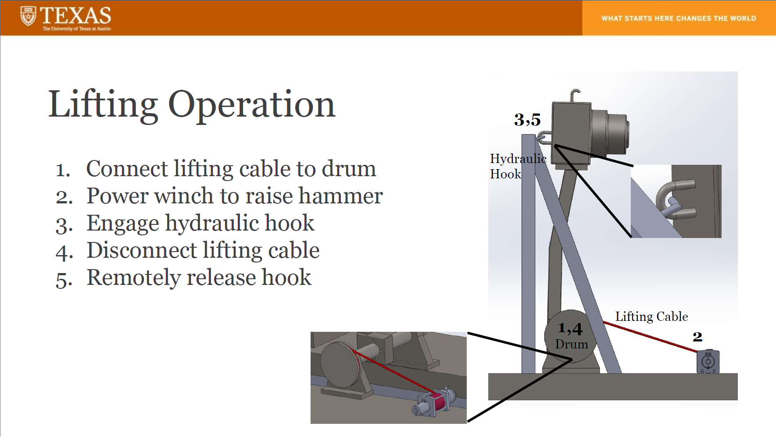
Senior Design Project Work and Results
Notes:
Besides my leader role, I was responsible for designing the Hammer, and in summary all the team members successfully delivered a CAD model and a static FEA result to the sponsor, and we wrote a report and a presentation for our sponsor and faculty members.

Slide 21
Q&A

